Slide 1
Computer Vision for
Coffee Bean Roast Classification
GTL Workshop – Artificial Intelligence
January 23, 2026
RoastAI: Diego Aguiar, Mariana Sambucetti, Catalina Vaz Martins.

Slide 2
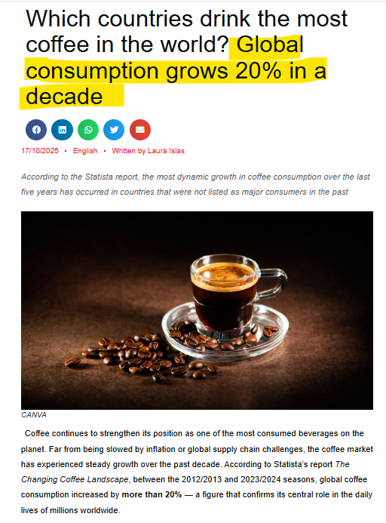
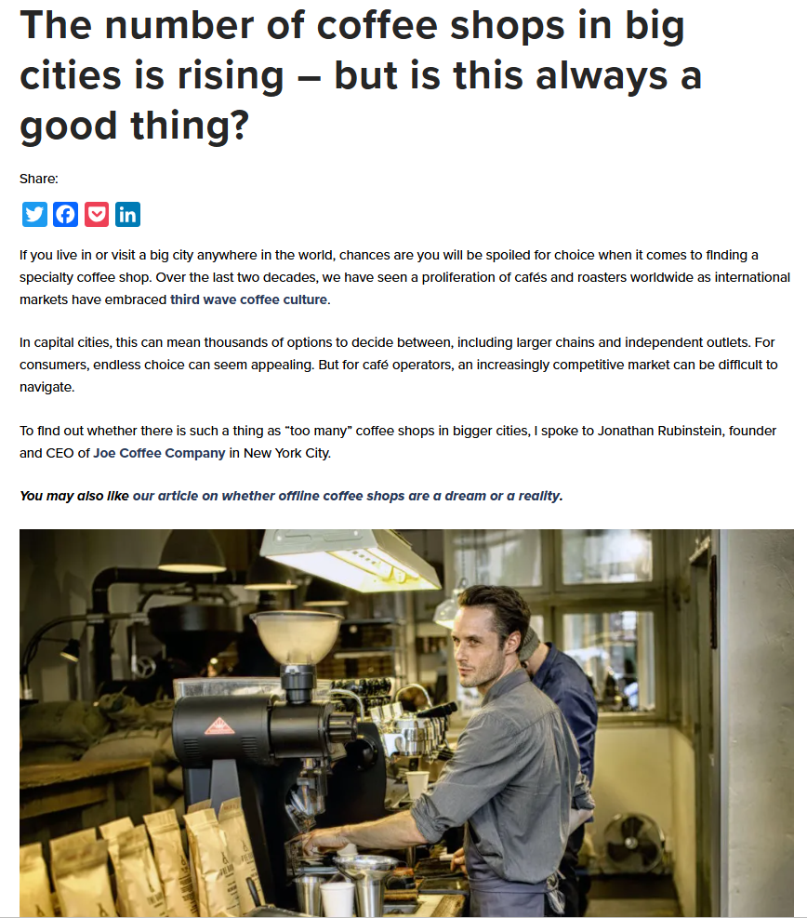
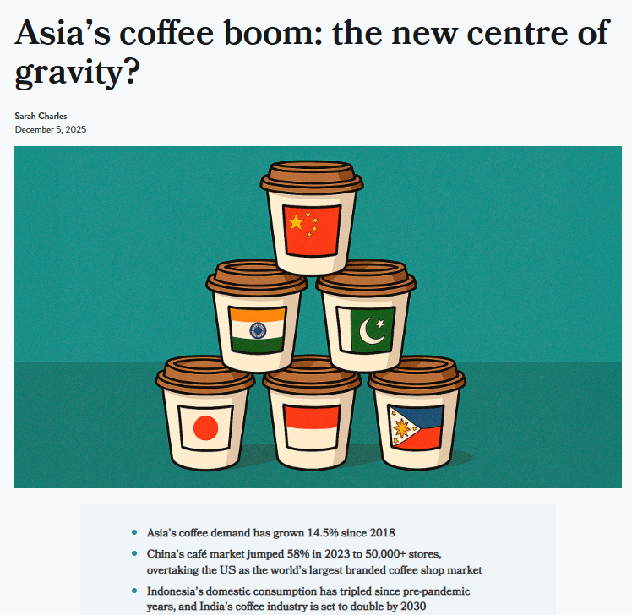
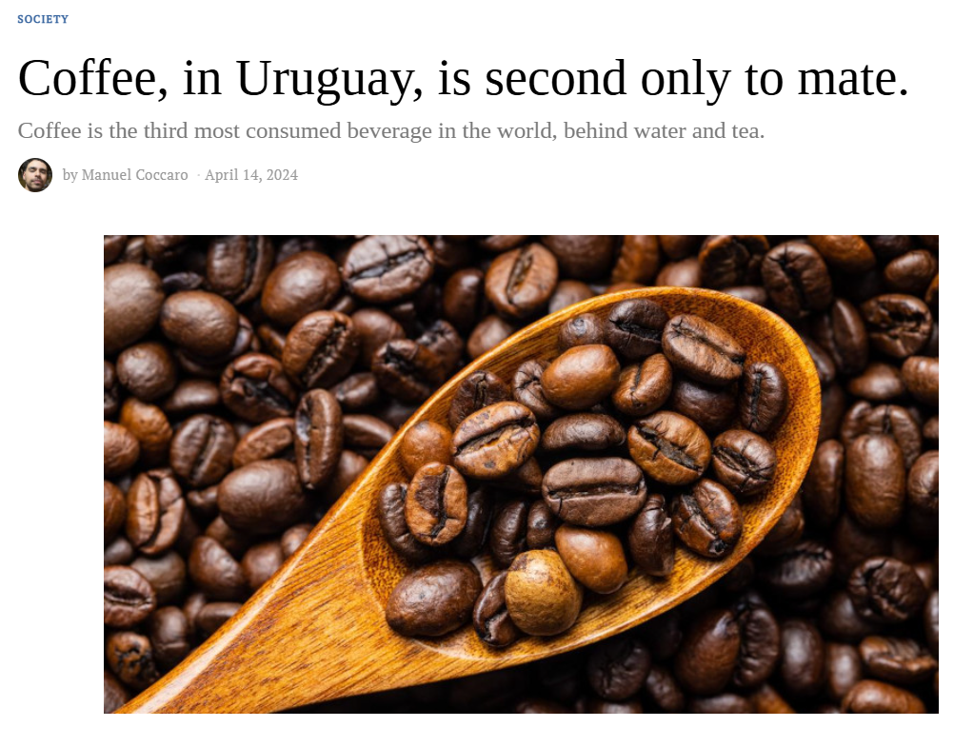
Quick Question…

Slide 3
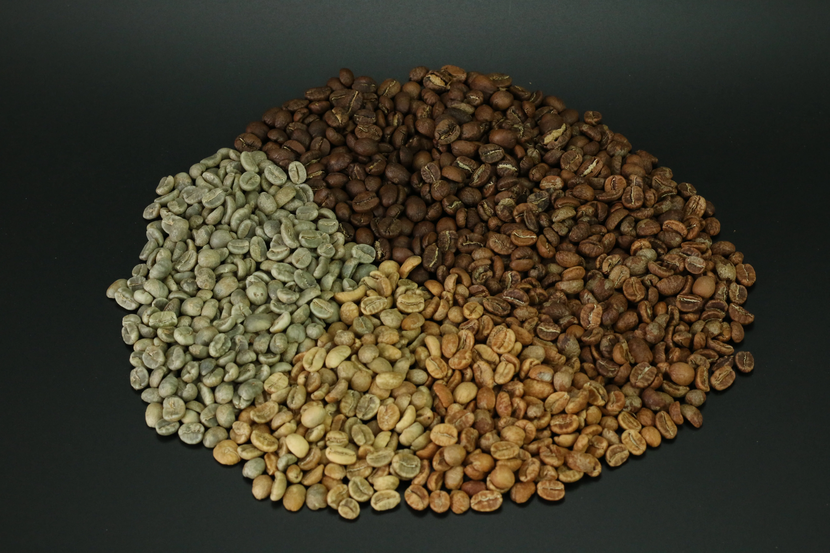
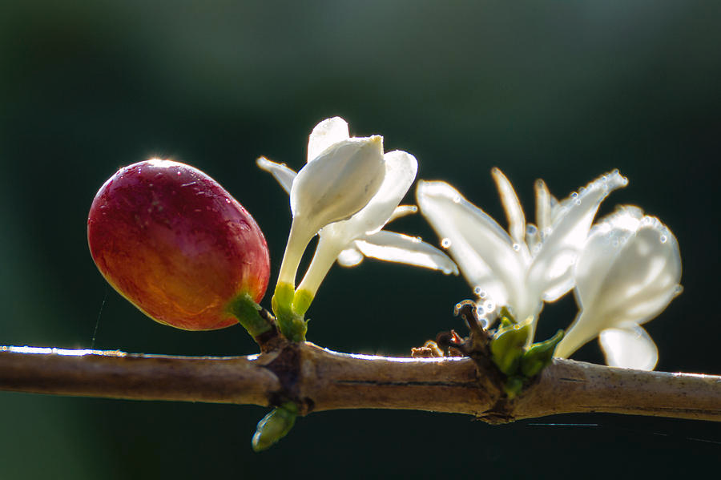

The Coffee Journey

Slide 4
What and how
Most people enjoy a good cup of coffee,
AND roasting is a key step that creates its flavors and aromas.
BUT identifying the correct roast level is difficult for humans, causing errors and extra costs.
THEREFORE, we are developing an automatic classification system to improve accuracy and efficiency.
OBJECTIVE develop an image-based machine learning model that classifies a coffee bean into four distinct roast levels to support automated quality control.

Slide 5
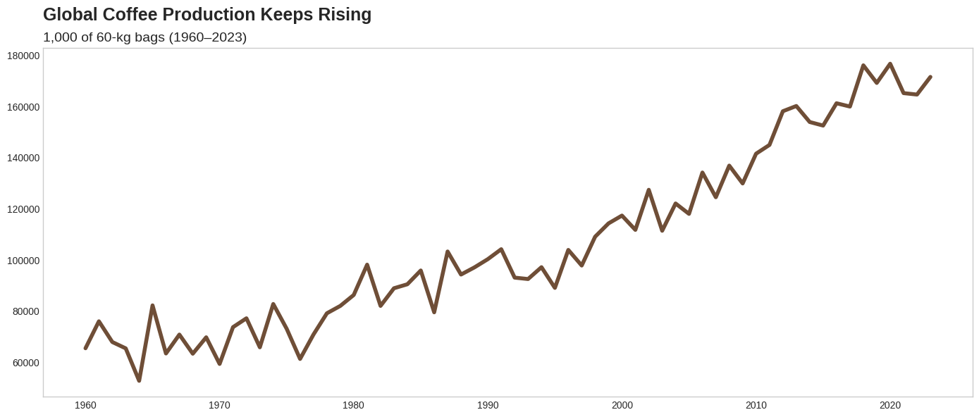
Coffee is a Global Growing Market

Slide 6
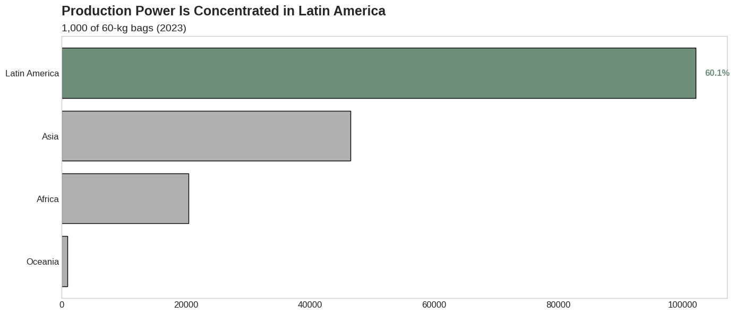
South America is a Key Coffee Producer

Slide 7
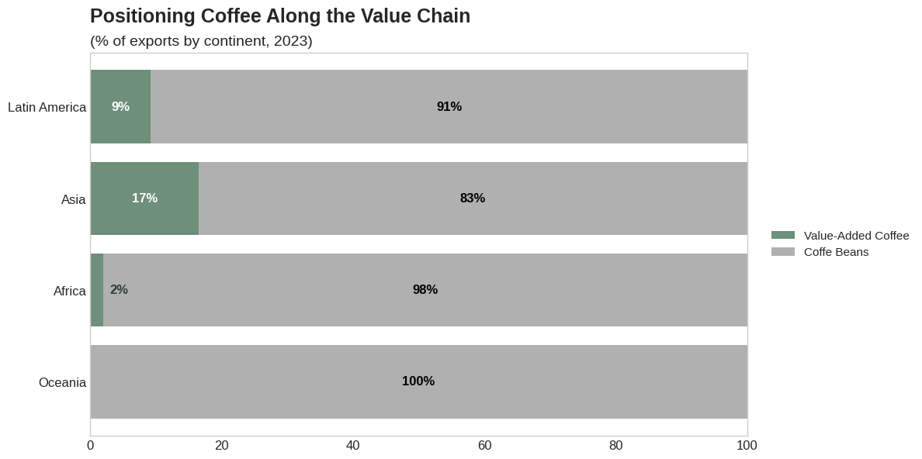
Quality Differentiation Drives Value

Slide 8
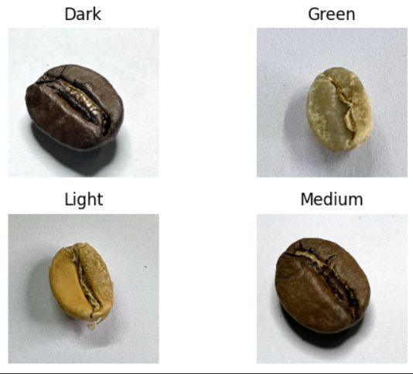
Roasting Levels
Green: Raw beans with green color and no roasting development
Light: Light brown color, higher acidity, origin flavors preserved
Medium: Balanced flavor, moderate acidity, fuller body
Dark: Dark brown color, bold flavor, low acidity, oily surface

Slide 9
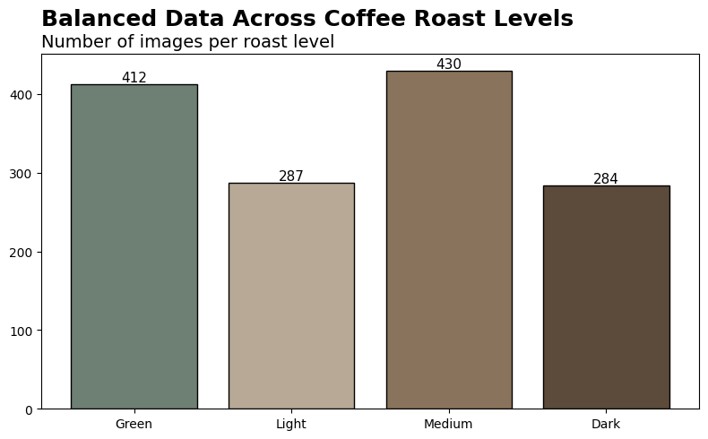
Our beans images
1,768 (1,413 Training) coffee bean images across 4 roast levels
Data sources:
Public dataset
Additional images collected by our team
Impact
Improved robustness and generalization
Better alignment with real-world usage

Slide 10
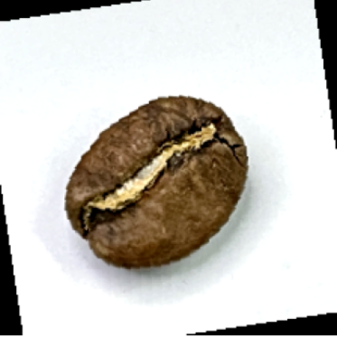
Teaching the Model How to See
What we have
Raw RGB images of coffee beans
No handcrafted features
No roast-specific rules
How we prepare the model input
Resized to 224 × 224
Normalized with ImageNet statistics
Data Augmentation

Slide 11
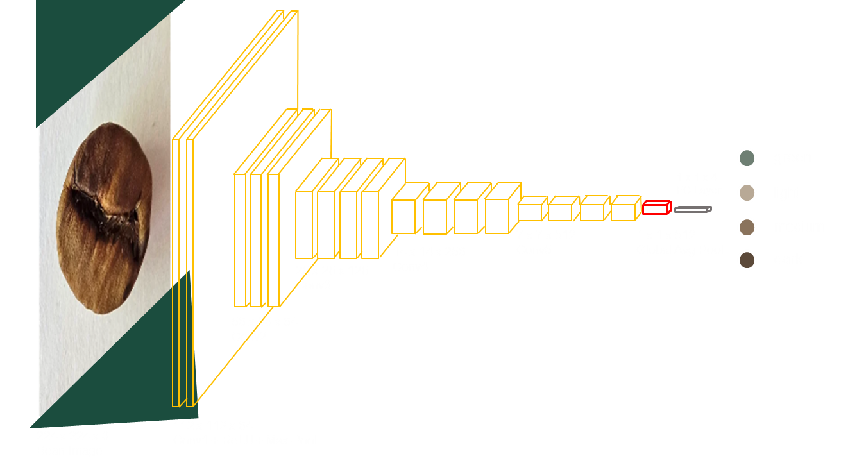
Choosing and Training the Model
ResNet-18
Notes:
Model architecture
ResNet-18, pretrained on ImageNet
Why ResNet-18:
Strong performance with limited data
Lightweight and fast
Practical for real-world deployment (apps, edge devices)
How we adapted it
Replaced final layer: 512 features → 4 roast classes
Training strategy
Transfer learning
Fine-tuned the full network
Optimization setup
Loss: Cross-Entropy
Optimizer: Adam
Batch training
Early stopping + best-model checkpointing
Key takeaway
We reused a powerful visual “brain” and retrained it to become a coffee roast expert.

Slide 12
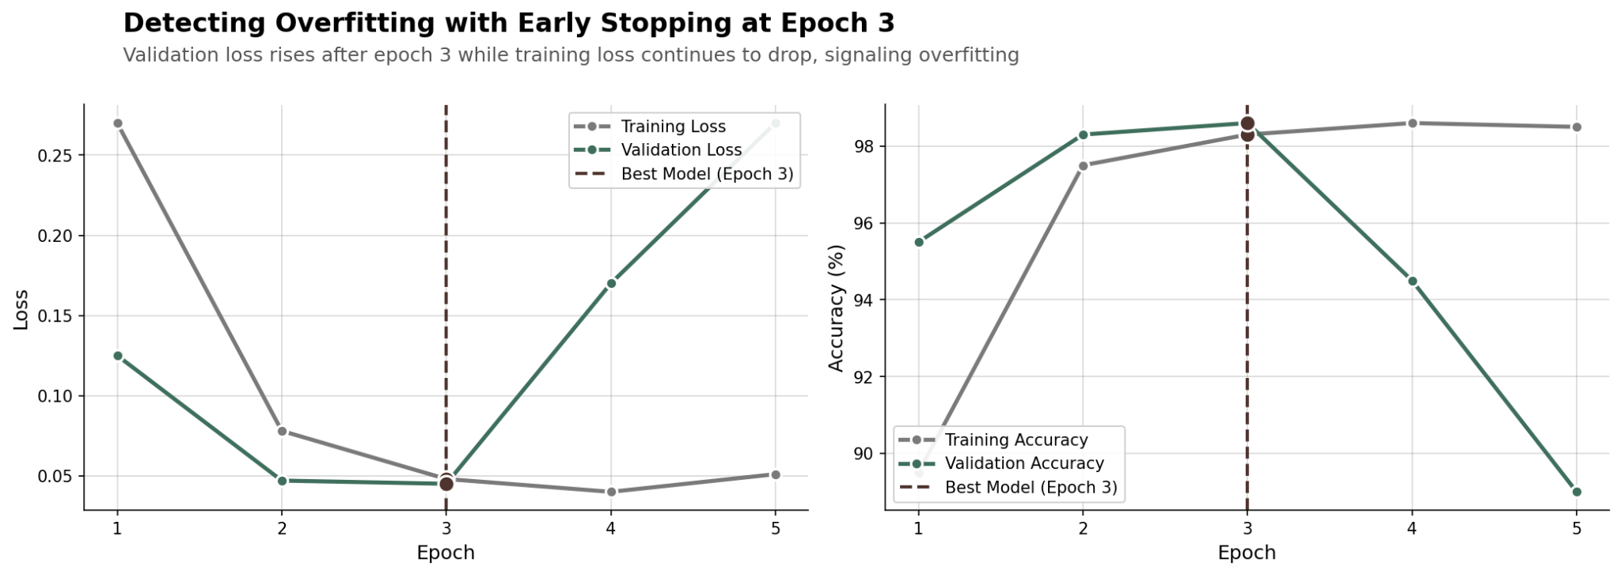
Hyperparameter Tuning & Training Strategy
Optimizer: Adam, lr = 1e-4
Max epochs: 15 with Early Stopping (patience=2, min_delta=0.001)
Stopped at epoch 5. Best model: epoch 3 (lowest val loss)
Notes:
Model architecture
ResNet-18, pretrained on ImageNet
Why ResNet-18:
Strong performance with limited data
Lightweight and fast
Practical for real-world deployment (apps, edge devices)
How we adapted it
Replaced final layer: 512 features → 4 roast classes
Training strategy
Transfer learning
Fine-tuned the full network
Optimization setup
Loss: Cross-Entropy
Optimizer: Adam
Batch training
Early stopping + best-model checkpointing
Key takeaway
We reused a powerful visual “brain” and retrained it to become a coffee roast expert.

Slide 13
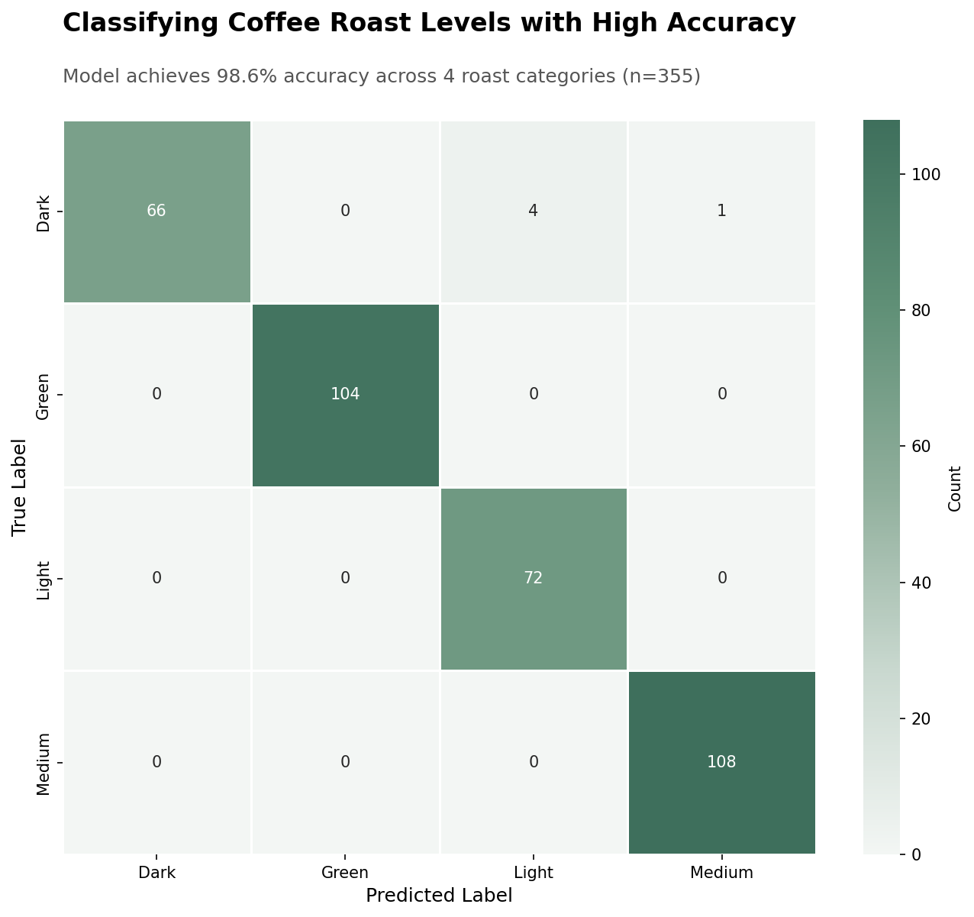
Measuring and Proving Model Performance
Test set size: N = 355 (20% holdout)
Per-class recall (to show robustness):
Dark: 0.93
Green: 1.00
Light: 1.00
Medium: 1.00
Overall accuracy: 0.99
Macro F1: 0.98

Slide 14
Conclusion
ML model can classify coffee roast levels
It is a scalable alternative to manual inspection
Strong potential for quality control
Limitations:
Images captured under controlled conditions
Model may need adaptation for different camera setups

Slide 15
Next Steps
Develop a mobile application to capture and upload coffee bean images
Integrate the trained model for real-time roast level prediction
Deploy the system for pilot testing in real roasting environments

Slide 16
Q&A

Slide 17
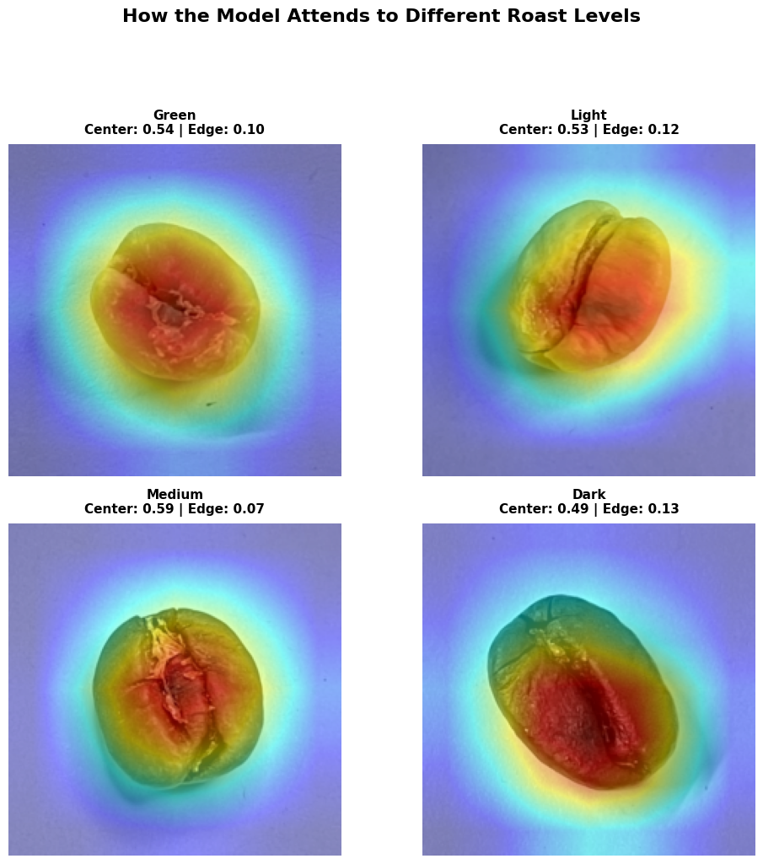
What the model is looking at
Center Attention: 0.507 ✓ (focuses on beans)
Edge Attention: 0.128 ✓ (ignores background)

Slide 18
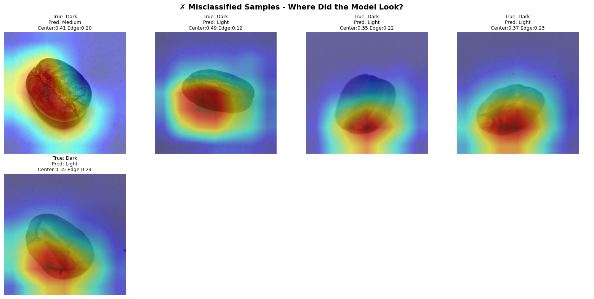
Missclassified

Slide 19
Hyperparameter Tuning & Training Strategy
Loss: Cross-Entropy (multi-class classification)
Optimizer: Adam, lr = 1e-4
Batch size: 32
Max epochs: 15 with Early Stopping (patience=2, min_delta=0.001)
Stopped at epoch 5. Best model: epoch 3 (lowest val loss)
Notes:
Model architecture
ResNet-18, pretrained on ImageNet
Why ResNet-18:
Strong performance with limited data
Lightweight and fast
Practical for real-world deployment (apps, edge devices)
How we adapted it
Replaced final layer: 512 features → 4 roast classes
Training strategy
Transfer learning
Fine-tuned the full network
Optimization setup
Loss: Cross-Entropy
Optimizer: Adam
Batch training
Early stopping + best-model checkpointing
Key takeaway
We reused a powerful visual “brain” and retrained it to become a coffee roast expert.

Slide 20
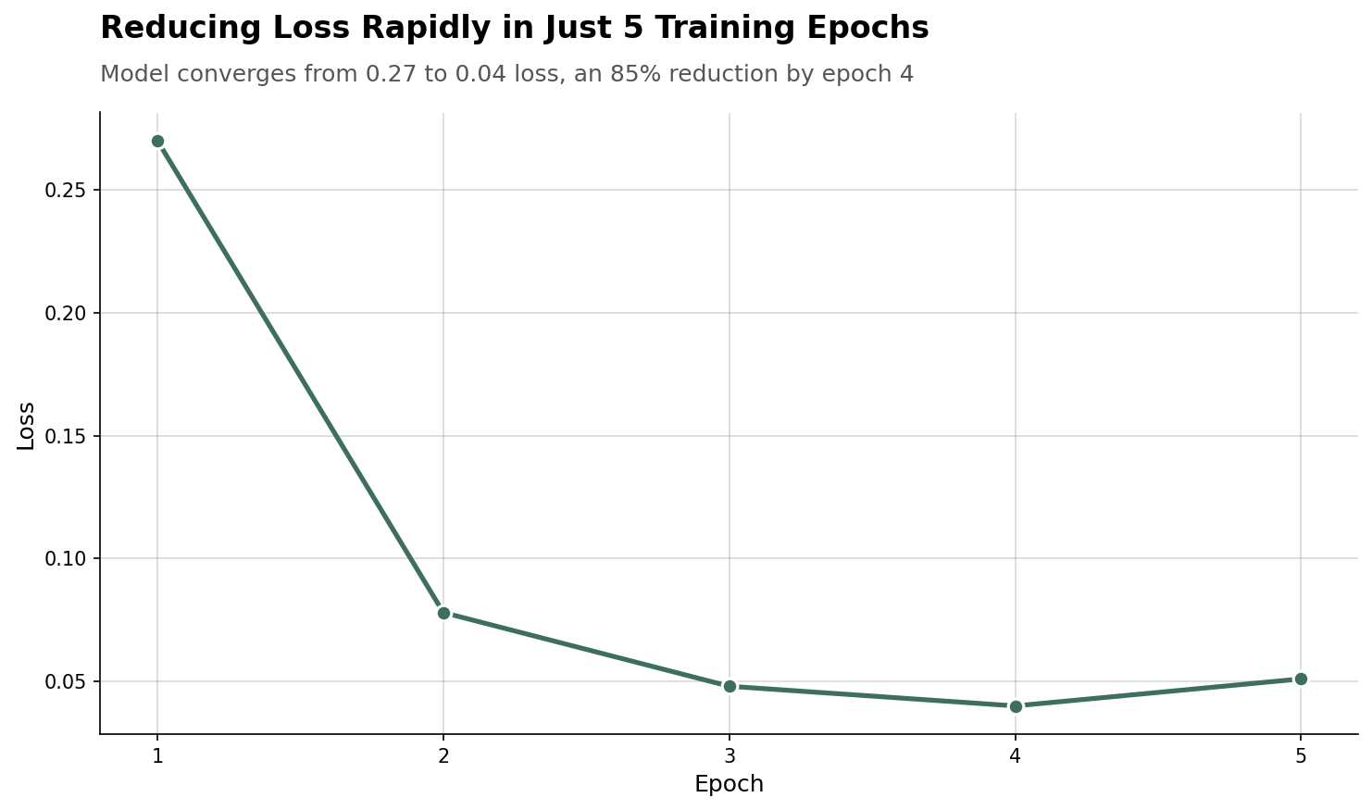
Measuring and Proving Model Performance

